Slide 1

20EC5203 ELECTRONIC DESIGN PROJECT- I
Presented by:
NANDHINI S (811722106062)
NITHYASRI M (811722106070)
SUDHARSANAN M (811722106114)
Under the Guidance of
Dr.S.SYEDAKBAR
HEAD OF THE DEPARTMENT
ECE

Slide 2
OUTLINE
ABSTRACT –MODULE 1
INTRODUCTION
BLOCK DIAGRAM
HARDWARE MODULE
ADVANTAGES AND APPLICATIONS
ABSTRACT –MODULE 2
INTRODUCTION
BLOCK DIAGRAM
HARDWARE MODULE
ADVANTAGES AND APPLICATIONS
CONCLUSION
PROJECT PLAN
REFERENCES

Slide 3
MODULE 1-AUTOMATED WATER PUMP CONTROLLER

Slide 4
ABSTRACT - MODULE 1
An automated water pump switcher is an advanced system designed to automate the operation of water pumps, ensuring efficient water management in various applications. This system utilizes sensors to continuously monitor the water levels in tanks, reservoirs, or wells. When the water level drops below a specified threshold, the switcher activates the pump to fill the tank. Conversely, when the tank reaches its maximum level, the system automatically turns off the pump to prevent overflow. This automation eliminates the need for manual control, reducing human effort and minimizing the risk of pump damage due to dry running or overloading. Additionally, it conserves energy by ensuring the pump operates only when necessary, thereby enhancing overall efficiency.

Slide 5
INTRODUCTION – MODULE 1
Water is a vital resource, and efficient water management is essential in residential, agricultural, and industrial sectors. Traditional methods of controlling water pumps often require manual operation, which can lead to inefficiencies such as water wastage, energy loss, and equipment damage due to human error. To address these challenges, an automatic water pump switcher has been developed as a smart solution that automates the process of water pumping based on real-time water level monitoring. This system ensures that the pump operates only when necessary, turning on when water levels are low and switching off when the desired level is reached. By integrating sensor technology, the automatic water pump switcher offers a reliable, energy-efficient, and cost-effective approach to water management, reducing manual labor while promoting sustainable use of resources.

Slide 6
Objectives: 1. Automation: The primary objective is to automate the water pump control process, ensuring efficient operation without manual intervention. 2. Resource Optimization: Achieve optimal water usage by activating the pump only when necessary (e.g., based on water level or other relevant conditions). Goals: 1. Reliable Pump Control: Develop a system that reliably turns the water pump on and off as needed. 2. Safety: Prevent pump overruns (which can damage the pump) and dry runs (which can cause equipment failure).

Slide 7
Scope:
1. Circuit Design: Design a reliable electronic circuit that senses water levels and controls the pump.
2. Component Selection Choose appropriate sensors, switches, and relays for the system. 3. Installation: Implement the system for specific applications (e.g., domestic water tanks, agricultural irrigation, industrial processes).

Slide 8
LITERATURE SURVEY
Ref. No | TITLE & AUTHOR | METHODOLOGY OR COMPONENTS USED | PROS | CONS
1 | Automated Water Pump Control System Using Arduino" by R. S. Khule et al. (2017) | Arduino-based microcontroller, sensors, and relay module | Low cost, easy implementation, flexible programming | Limited scalability, no remote monitoring
2 | "IoT-Based Smart Water Pump Controller" by A. K. Singh et al. (2019) | IoT-based ESP8266 microcontroller, sensors, and mobile app | Real-time monitoring, remote control, data analytics | Higher cost, dependency on internet connectivity
3 | Intelligent Water Pump Control Using Fuzzy Logic" by M. A. Khan et al. (2020) | Fuzzy logic control, sensors, and microcontrolle | Optimized energy efficiency, adaptive decision-making | Complexity in algorithm design, requires expertise
4 | "Automated Water Pump Control System Using SCADA" by S. S. Patil et al. (2018) | SCADA-based system, sensors, and programmable logic controller | Scalable, reliable, real-time monitoring | High installation cost, complex setup
5 | "Wireless Sensor Network-Based Water Pump Control" by A. M. Abu-Almajd et al. (2020) | Wireless sensor network, microcontroller, and GSM module | Real-time monitoring, remote control, low cost | Limited range, interference issues

Slide 9
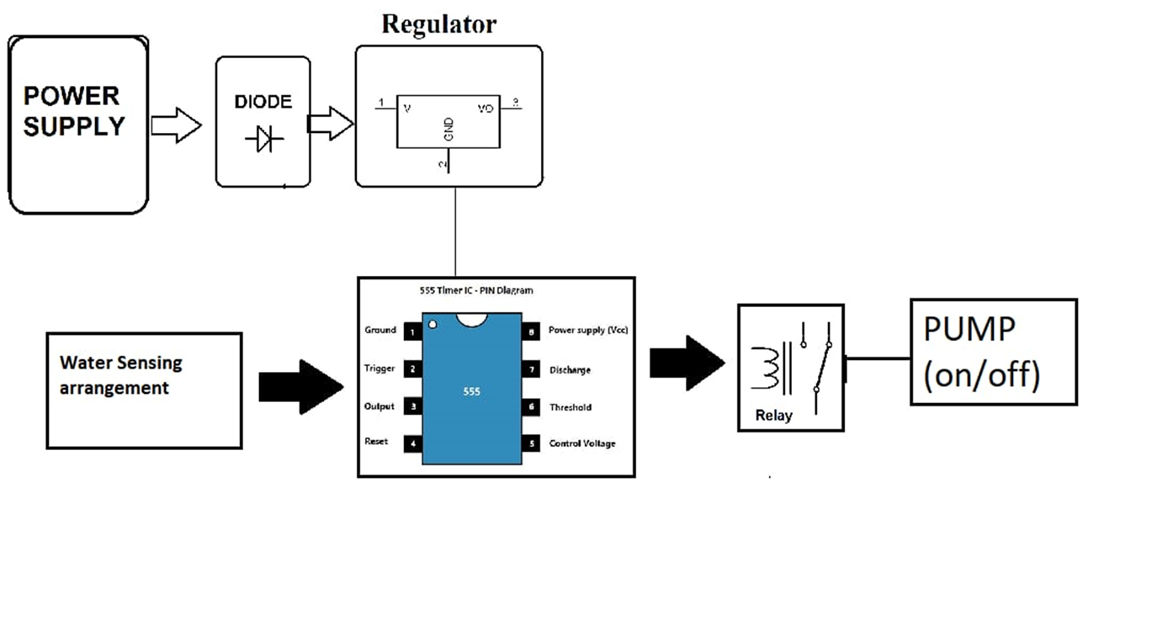
BLOCK DIAGRAM

Slide 10
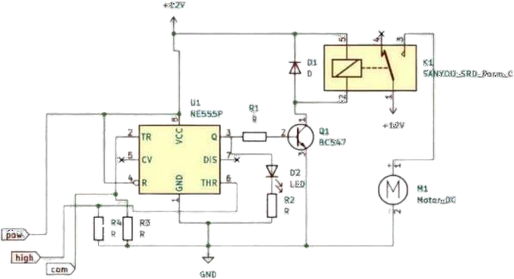
CIRCUIT DIAGRAM

Slide 11
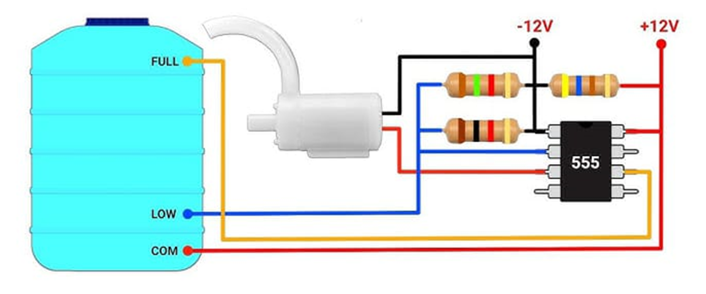

Slide 12
HARDWARE MODULE
555 Timer IC
Resistor
Capacitor
Cables and Connectors
Diodes
Bread board
LED’S
Switch
Relay

Slide 13
ADVANTAGES AND APPLICATIONS
Advantages:
Cost-Effective
Convenience
Automatic operation
Time Saving
Easy Installation
Consistence Water Pressure
Enhanced Safety

Slide 14
Applications:
1.Home Water Tanks
2.RainWater Harvesting 3.Garden Irrigation
4.Industrial Processes 5.Animal Watering
6.Water Tank and Reservoirs 7.Fire fighting Systems

Slide 15
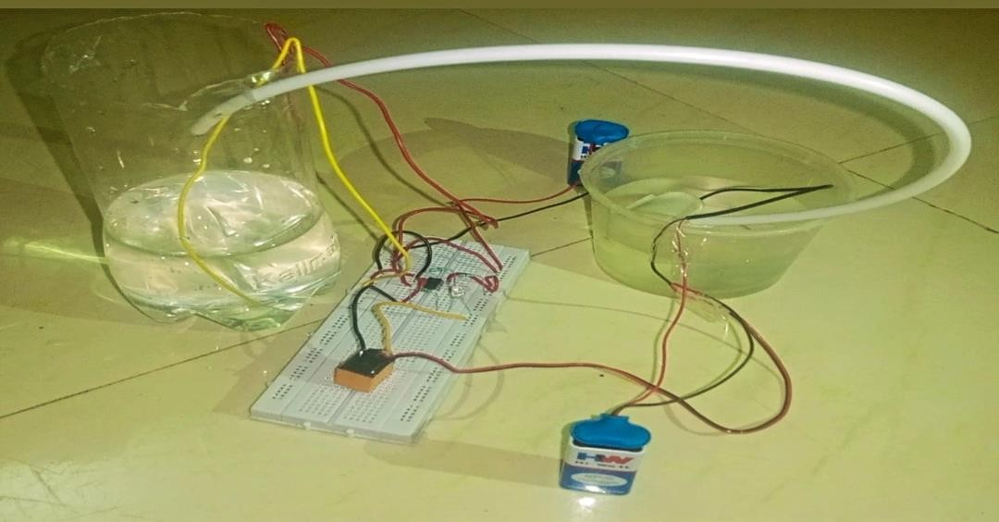
WORKING MODEL:
DEMO VIDEO

Slide 16
MODULE 2 -AUTOMATIC ROOF SHED BY USING RELAY

Slide 17
ABSTRACT
An automated roof shed system using relays is designed to provide smart, efficient control over the opening and closing of roof structures, typically for agricultural, industrial, or residential applications. The system uses sensors to detect environmental conditions such as rain, sunlight, or temperature and activates the roof shed accordingly through relay switches. When specific conditions are met, such as rain detection, the relay triggers the motor to close the roof, protecting the area underneath. Conversely, the system opens the roof when favorable conditions return. This automation eliminates the need for manual intervention, ensures timely operation, and enhances the protection of crops, equipment, or living spaces. The use of relays offers reliable switching, low power consumption, and precise control, making the system cost-effective and energy-efficient. Overall, it promotes convenience, resource conservation, and improved environmental adaptability.

Slide 18
INTRODUCTION
An automatic roof shed system using a relay is a simple yet effective solution designed to provide automated control over a roof covering mechanism. By utilizing sensors, such as rain or temperature sensors, in conjunction with a relay switch, the system can detect environmental conditions and trigger the opening or closing of the roof shed accordingly. This setup ensures optimal protection against weather changes, enhances convenience, and reduces the need for manual intervention, making it ideal for use in homes, agricultural setups, or industrial environments.

Slide 19
Objectives:
Provide automated protection for indoor or outdoor spaces from weather conditions.
Minimize manual intervention for roof adjustments.
Enhance comfort, safety, and usability of spaces.
Scope:
Residential Applications:Automated terrace roofs for weather protection and ventilation.Carports to shield vehicles from rain, sunlight, and snow.Patios and balconies with adjustable shading options.
Commercial Spaces:Retractable roofs for outdoor restaurants, cafes, and event spaces.Shopping malls and atriums for natural light.

Slide 20
Goals:
Develop an efficient and user-friendly automatic roof shed system.
Extend usability of spaces in all weather conditions.
Ensure minimal energy consumption and low maintenance.

Slide 21
LITERATURE SURVEY
REF. NO | TITLE & AUTHOR | METHODOLOGY OR COMPONENTS USED | PROS | CONS
1 | Automatic Motorized Roof Control System using Relays and Sensors by R. Kumar, S. Desai, A. Sharma | The system uses rain sensors and temperature sensors to control the motor of the roof automatically via relays. When | Automatic control based on weather conditions., Energy-efficient. | Requires periodic sensor maintenance
2 | Design of Automatic Sliding Roof System using Relay and Rain Sensor by A.Gupta, N. Singh, M. Patel | The system design incorporates relays and rain sensors to automate the opening/closing mechanism of a sliding roof | Protects from rain and excessive sunlight. | Only works for sliding roofs.
3 | IoT-based Automatic Roof System using Relay and Sensor Network by V. Sharma, R. Pandey, K. Verma | The system integrates IoT with relay and sensor modules to remotely control the roof. | User-friendly interface. | Requires stable internet connection.
4 | Smart Roof Management System Using Sensor-Based Relay Control by P. Mehta, D. Choudhary, K. Prasad | The system uses a sensor-based relay control for roof management. | Real-time weather monitoring. | Complex setup.
5 | Automated Roof Control System with Relay-Based Weather Monitoring by S. Raj, B. Kumar, N. Dey | The system automates the opening and closing of a roof by using weather data from a set of sensors. | Multi-sensor integration ensures better weather response. | Expensive due to multi-sensor integration.

Slide 22
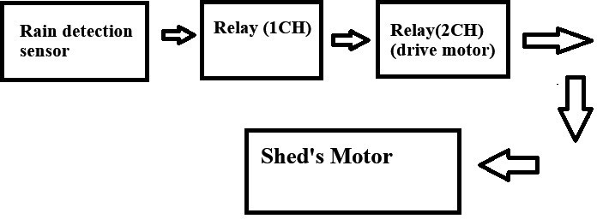
BLOCK DIAGRAM

Slide 23
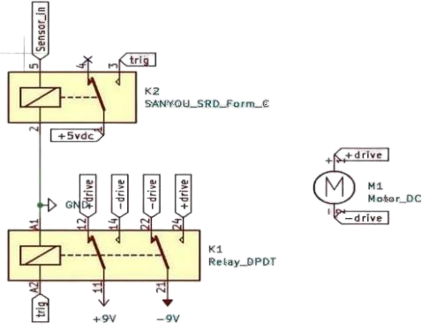
CIRCUIT DIAGRAM

Slide 24
HARDWARE MODULE
Two channel relay
One channel relay
Rain Sensor
9v Battery

Slide 25
ADVANTAGES AND APPLICATIONS
Cost Maintenance
Automation
Energy-Efficient
Durability
Simple Design and Implementation
Weather Protection
Low Maintenance
Safety

Slide 26
APPLICATIONS
Residential Buildings
Greenhouses
Industrial Warehouses
Parking Lots and Garages
Stadiums and Arenas
Cafes and Restaurants with Outdoor Seating

Slide 27
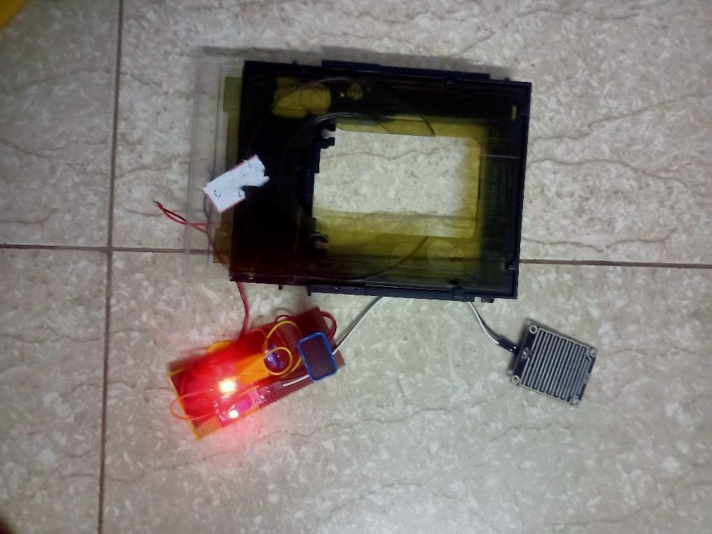
WORKING MODEL:
DEMO VIDEO

Slide 28
CONCLUSION
The Automated Water Pump Controller is an efficient solution for managing water pumps, ensuring optimal operation through automation. It uses sensors to monitor water levels and controls the pump based on real-time data, preventing water wastage and energy inefficiency.
The Automated Roof shed using a relay system is an innovative solution that enhances the functionality and convenience of roof shields. The system automatically opens or closes the roof based on environmental factors such as weather conditions, using a relay for controlling the motor.

Slide 29
REFERENCES
.
Abate.A , Bessa.I, Cattaruzza.D, Chaves.L, Cordeiro.L, David.C, et al.,“DSSynth”Proc. Vol 32,n0.5, Oct. 2021.
Bertsekas.D.P, Dynamic Programming and Stochastic Control, Orlando, FL,USA:Academic,vol 9,no.4, 2020.
Camacho.E.F and Alba.C.B., Model Predictive Control, London,U.K.:Springer,vol 12,no.4, 2023.
Donzé.A and Maler.O, “Robust satisfaction of temporal logic over real-Valued signals”, pp. 92-106,vol 6,no.3, 2022.
Fan.C, .Mathur.U, Mitra.S and Viswanathan.M “Controller synthesis madeReal”,Proc. 30th Int. Conf. Comput.vol 5,no.3, 2018

Slide 30
REFERENCES
6. Kumar.K.C. et al., “Design and Development of Automated Water Roof ShedController Using Arduino, vol. 69, no. 5, pp. 1054-1061, May 2021.
7.Mishra.P.K. et al., “Automated Water Roof Shed Controller Using MachineLearning-Based IoT System,” vol. 16, no. 4, pp. 2314-2323, April 2020.
8.Singh.G et al., “IoT-Based Automated Water Roof Shed Controller for SmartBuildings,”, vol. 7, no. 4, pp. 3414-3423,April 2020.
9.Yang Z.L and Chen.G”Design and research of amphibious cleaning robot.vol 8, 112-116, Jul. 2017.
10.Yuyi.Z, Yu.Z , Huanxin.L ,Yunjia.L and Liang.L, “Control system design For a surface cleaning robot”, vol. 10, pp. 220, Jan. 2013.

Slide 31
THANK YOU

